Slide 1
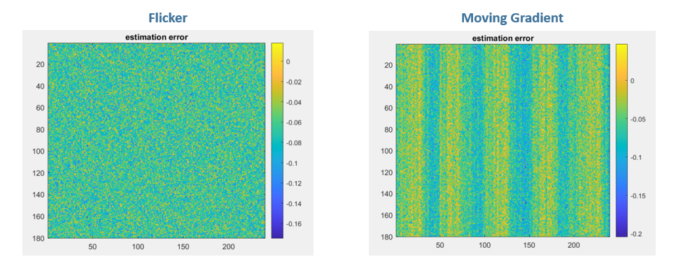
(a)
(b)

Slide 2


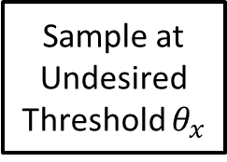

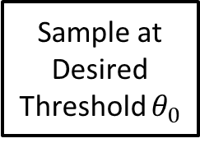

Sampling Perspective
Sample at Undesired Threshold $θ_{x}$
$$L\left(t\right)$$
$$e_{x}=\left\{t_{x},p_{x}\right\}$$
We want to create this conversion
Sample at Desired Threshold $θ_{0}$
$$L\left(t\right)$$
$$e_{0}=\left\{t_{0},p_{0}\right\}$$

Slide 3
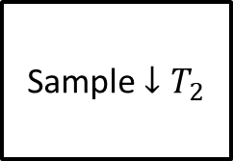


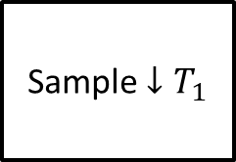

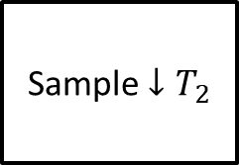



Regular Sampling – Sample Rate Conversion
Sampling Correction
$$L\left(t\right)$$
Sample $↓T_{1}$
$$L_{T_{1}}\left[n\right]$$
Reconstruct
$$\hat{L}\left(t\right)$$
Sample $↓T_{2}$
$${\hat{L}}_{T_{2}}\left[n\right]$$
Ideal Sampling
$$L\left(t\right)$$
Sample $↓T_{2}$
$$L_{T_{2}}\left[n\right]$$

Slide 4
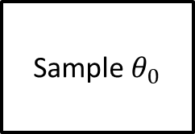

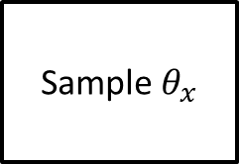
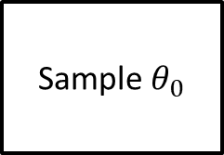


Event Sampling – Threshold Conversion
Sampling Correction
$$L\left(t\right)$$
Sample $θ_{x}$
$$\left\{t_{x},p_{x}\right\}$$
FOH Reconstruct
$$\hat{L}\left(t\right)$$
Sample $θ_{0}$
$$\left\{{\hat{t}}_{0},{\hat{p}}_{0}\right\}$$
Ideal Sampling
$$L\left(t\right)$$
Sample $θ_{0}$
$$\left\{t_{0},p_{0}\right\}$$

Slide 5
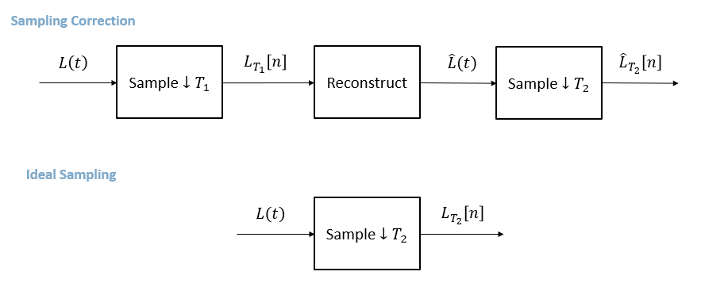
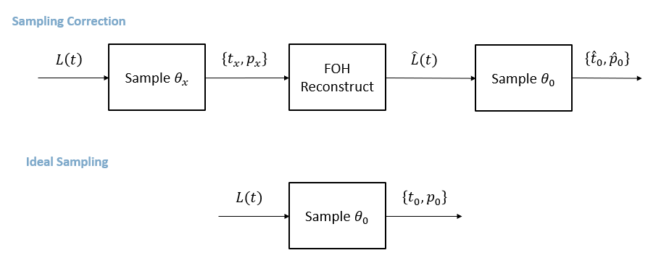
Event Sampling – Threshold Conversion
(a)
Regular Sampling Rate Conversion
(b)
Event Sampling Threshold Conversion

Slide 6














$$\log\left(I\right)$$
$$(k+1)θ$$
$$kθ$$
$$(k−1)θ$$
$$t$$
$$t_{i−1}$$
$$t_{i}$$
$$t_{i+1}$$
$$t_{i+2}$$
$$p$$
$$+$$
$$+$$
$$−$$
$$−$$

Slide 7
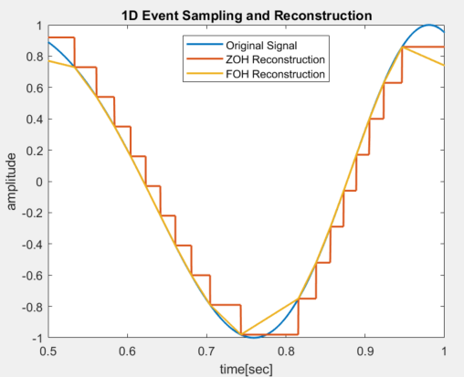
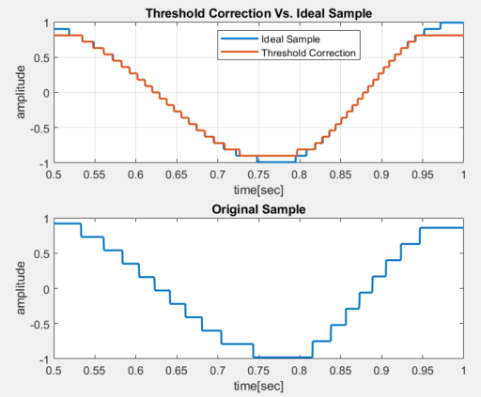
Reconstruction Example and Correction
(a)
(b)
(c)

Slide 8
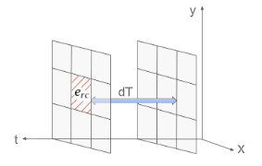
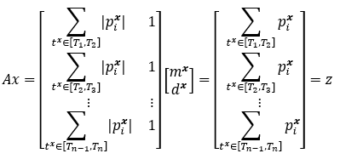
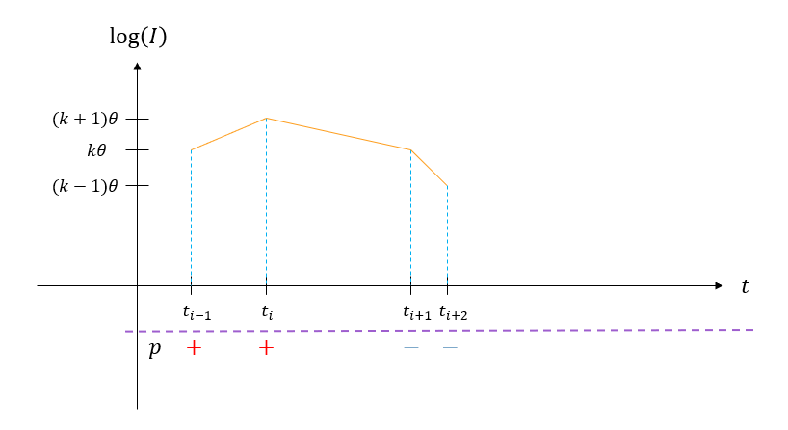
Denoising Pipeline
(a)
Offline Estimation
Background Activity Denoising
Threshold Estimation
Raw Data
(b)
Online Operation
Background Activity Denoising
Threshold Correction
Raw Data

Slide 9


Estimation Scenes
(a)
Moving Gradient
(b)
Flicker

Slide 10
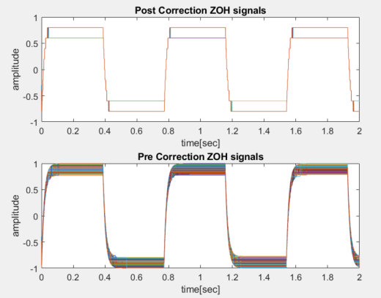
Correction without Estimation Error
(a)
(b)

Slide 11
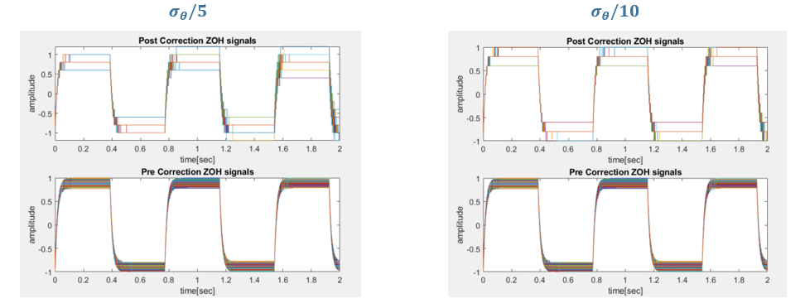
Correction with Estimation Error
(a)
(c)
(b)
(d)

